Slide 1

Startup companies
Exploratory Data Analysis

Slide 2
Objective
why majority of startups with percentage of 58.6% start in USA? how does it vary by country to another?
32.4% of startups are in California state
7% of them are in New York City

Slide 3
Quantitative Analysis

Slide 4
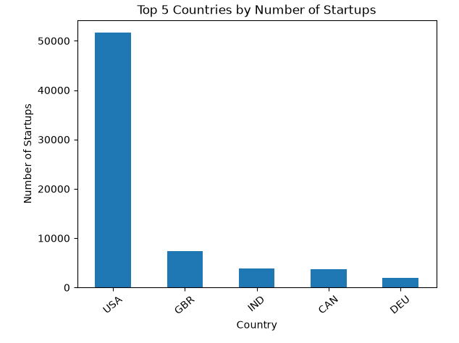

Slide 5
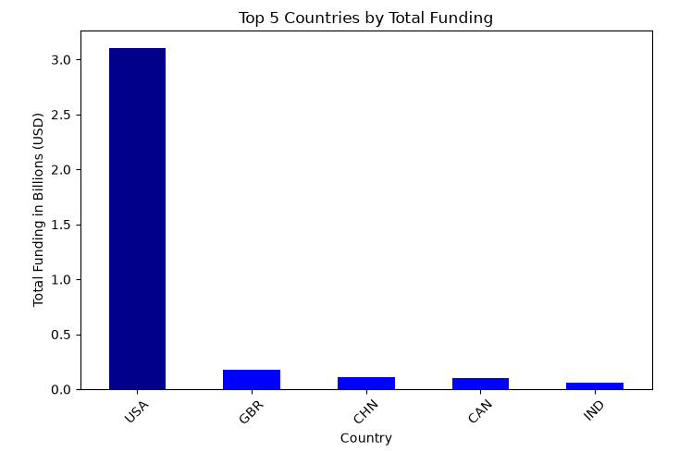

Slide 6
Remarkable numbers in USA
high funding reaching 33% worldwide
highest ROI 13333.33 USD

Slide 7
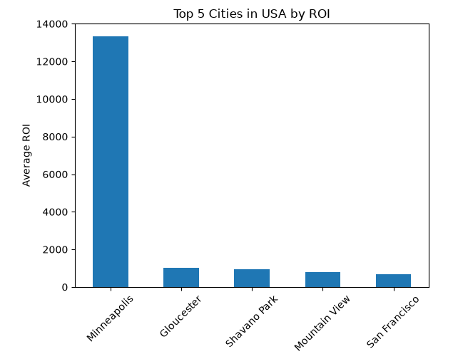

Slide 8
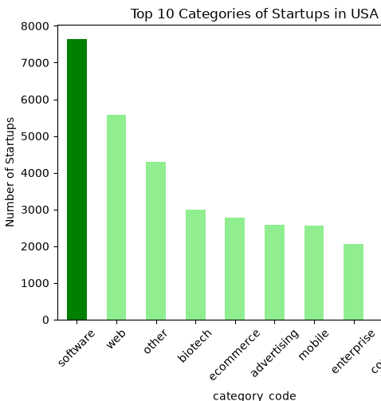
16% of startups in USA are in software

Slide 9
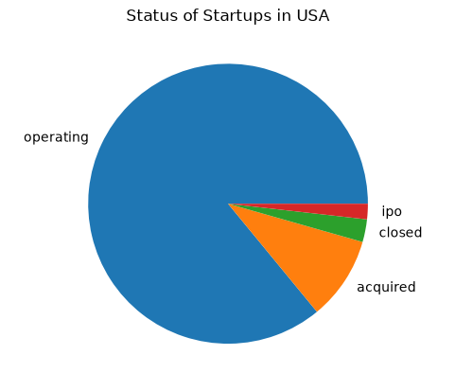
operating 85.9% acquired 9.6% closed 2.6% ipo 1.7%

Slide 10
Qualitative Analysis
venture capital firms, angel investors
Supportive Infrastructure and Resources
Government Policies and Regulations
Intellectual Property Protection

Slide 11
Startups in USA vs Europe
Labor Laws
Financing and Venture Capital
Education & Talent
Culture and Consumers

Slide 12
Resources
https://www23.statcan.gc.ca/imdb/p3VD.pl?Function=getVD&TVD=53971
Entrepreneurism in Europe vs U.S.: Why the “American Dream” is Still Best — Mount Bonnell Advisors

